Slide 1

Airbnb Yearly Revenue Prediction Ashley Jiangyang Data Science intensive Capstone Project Mar, 2020

Slide 2
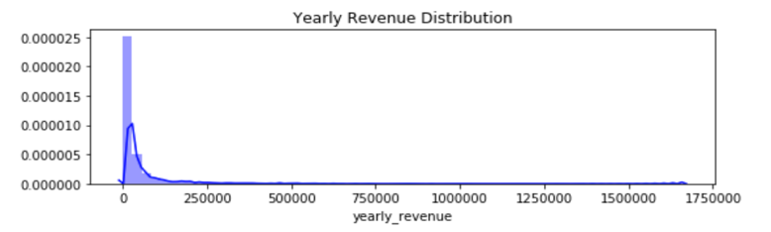
The Problem
Airbnb Yearly Revenue – How much can you make on the platform?
On average globally, Experience hosts earn $10,000 a year [Airbnb 2019 Business Updates]
Seattle – which is one of Airbnb’s largest US markets
What factors affect the host’s yearly revenue?
Can we predict the yearly revenue?

Slide 3
Who might care?
Airbnb
Hosts who active on the platform
People who want to invest the platform/listing
Other Housing Agencies: Priceline.com, Booking.com

Slide 4
What factors affect yearly revenue for a listing on Airbnb?
Market: City, Location, Culture, Event
Host Activeness & Management
Listing Attribute: Area, Facilities, Accommodates
Customer * Guest Interaction
Data Source
- Inside Airbnb
- http://insideairbnb.com/get-the-data.html

Slide 5
Data Information
Data acquired: Data Complied: 22 February, 2020
Number of records: 7,544
Number of features: 106
Data Cleaning
Drop Features
Recoding
Deal with Missingness
Outlier Detect
Define the Target Features
Final Data
Number of records: 6,583
Number of features: 80

Slide 6
Data Exploration
Yearly Revenue
Host Activeness on the Platform
Listing Accommodates & Facilities
Interactive Relationship
Geographical Information

Slide 7
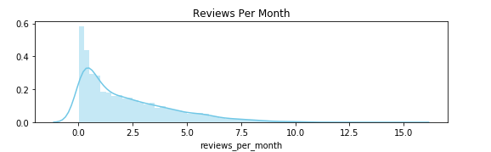
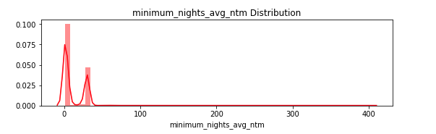
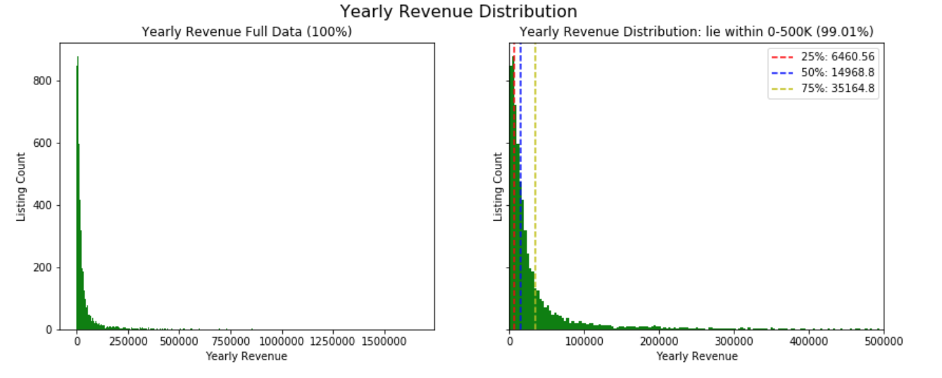
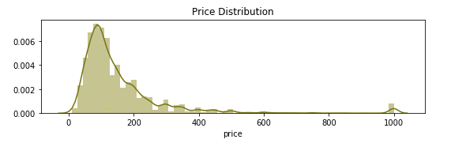
Yearly Revenue
Definition:
Estimated Booking in Year = reviews_per_month * 12 / 50%
Occupancy Rate = Estimated Booking in Year * minimum_nights_avg_nt /365
Yearly Revenue = price * Occupancy Rate * 365

Slide 8
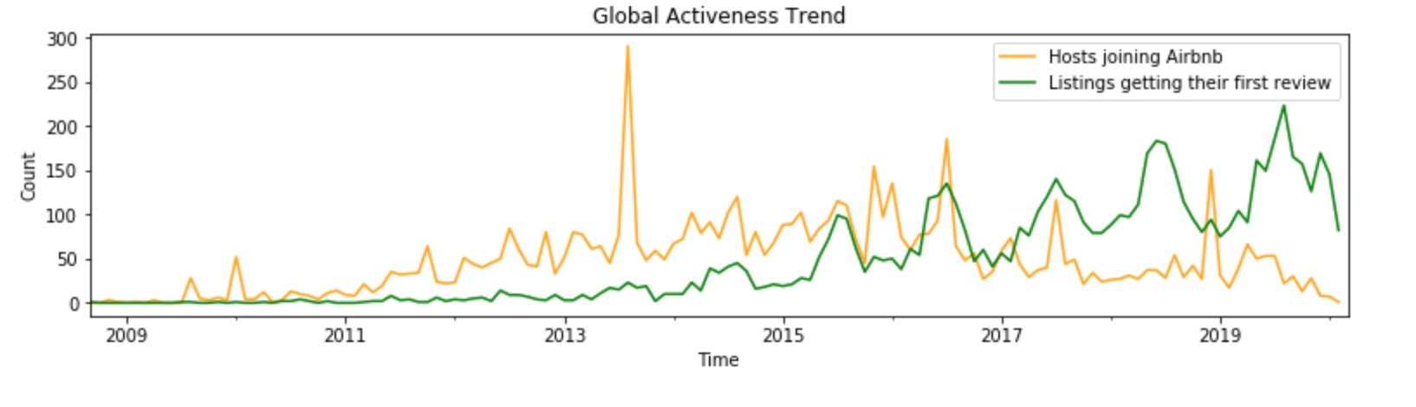
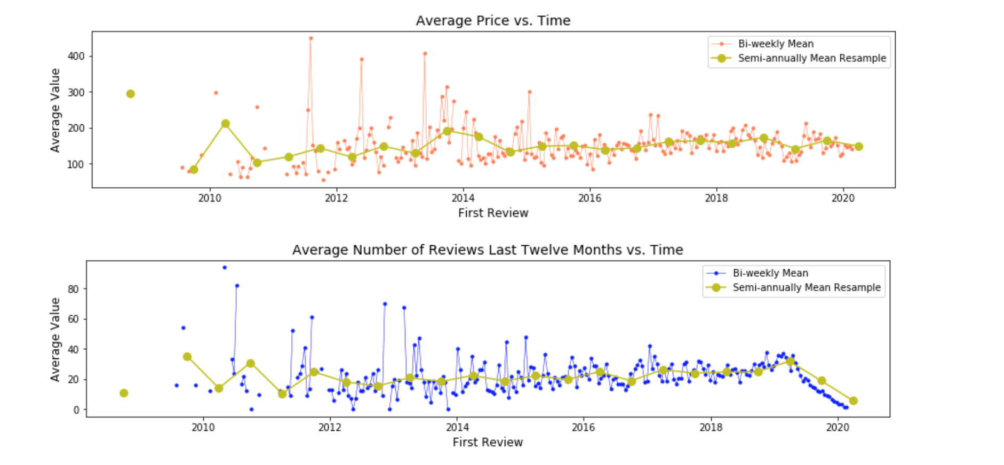
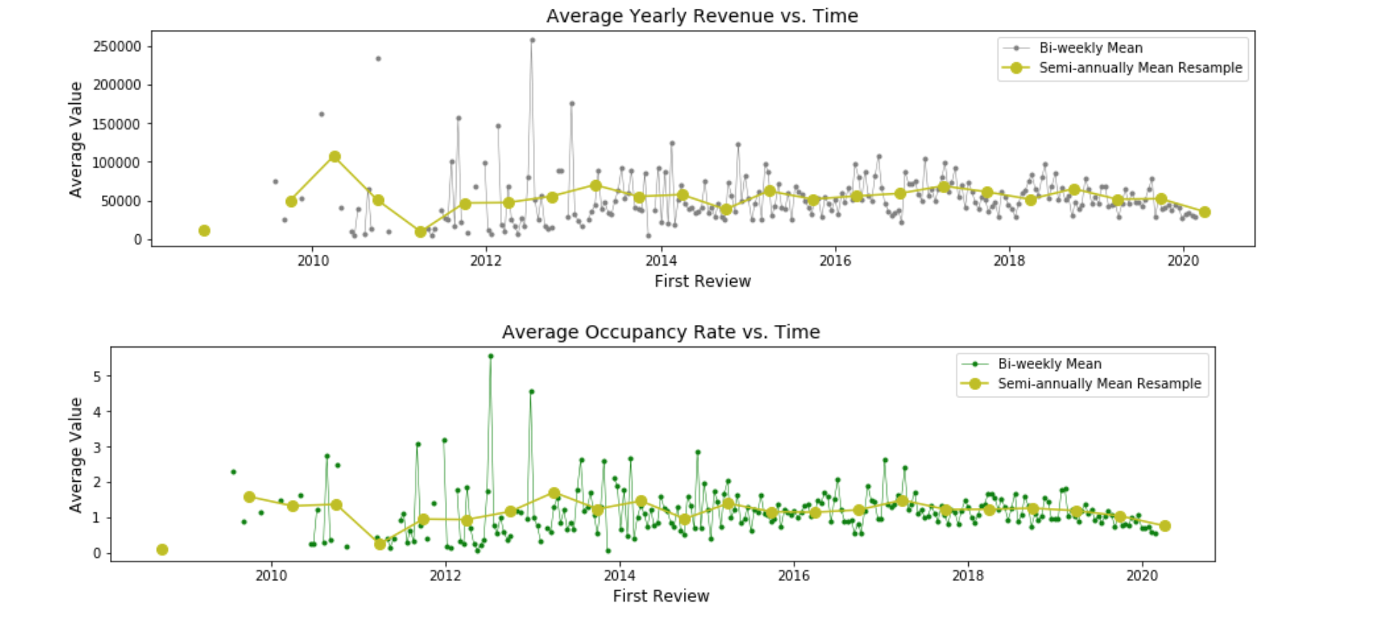
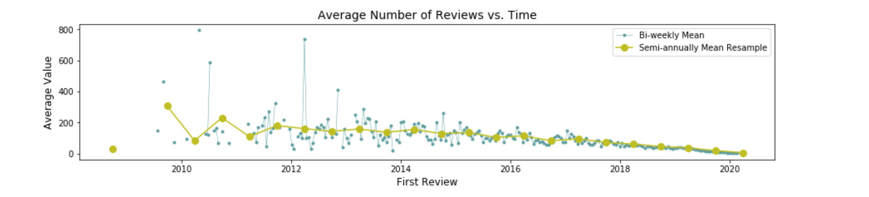
Host Activeness on the Platform
Global Business Trends
Join & Active
Price
Yearly Revenue
Number of Review Last 12 Month
Occupancy Rate
Number of review

Slide 9
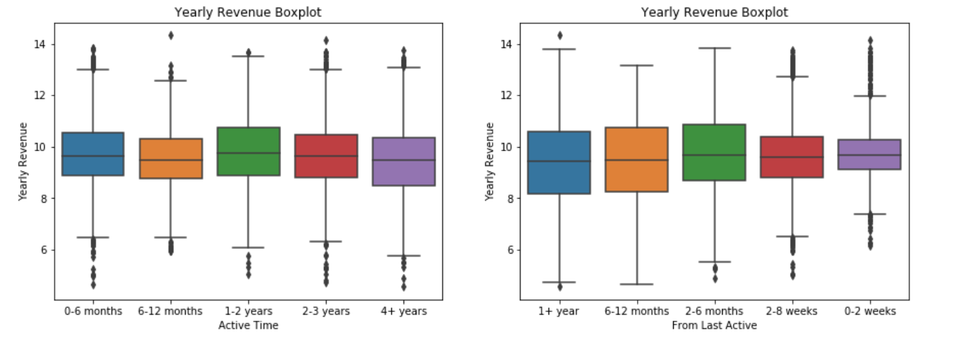
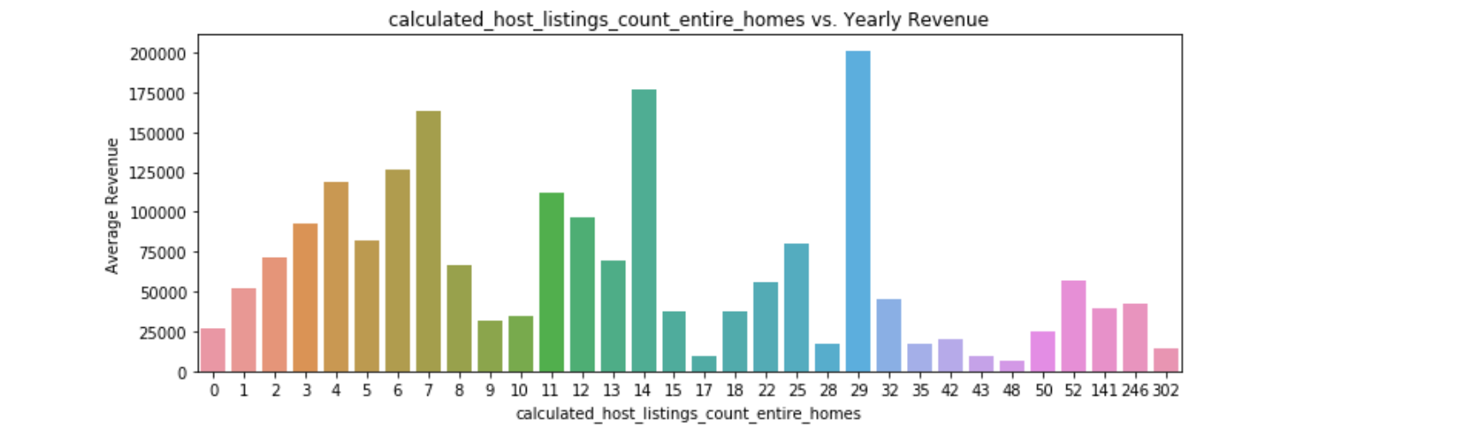
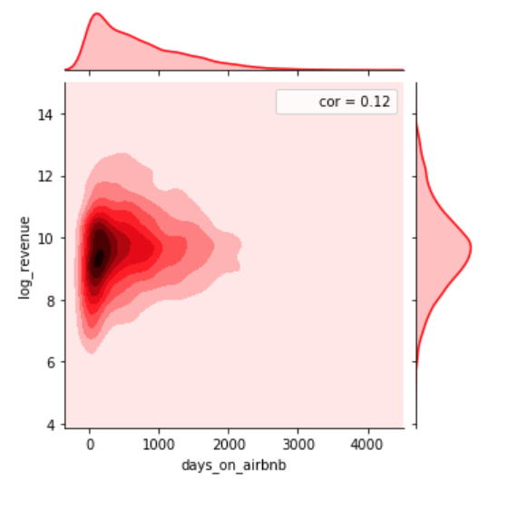
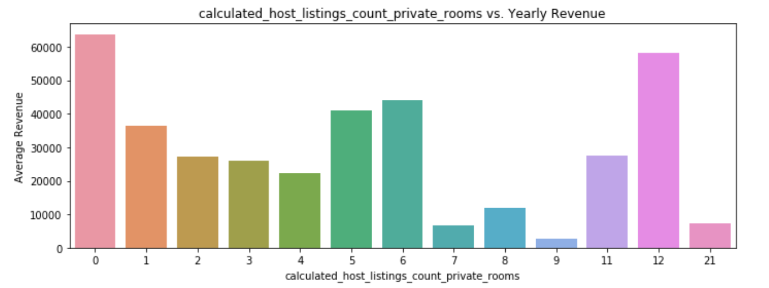
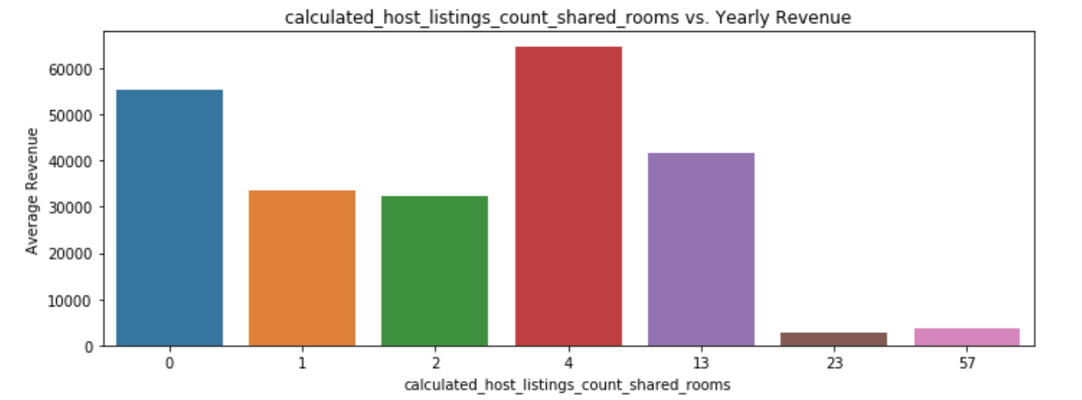
Host Activeness on the Platform
Power of Attraction & Staying
Host Listing Counts
Days on Airbnb

Slide 10
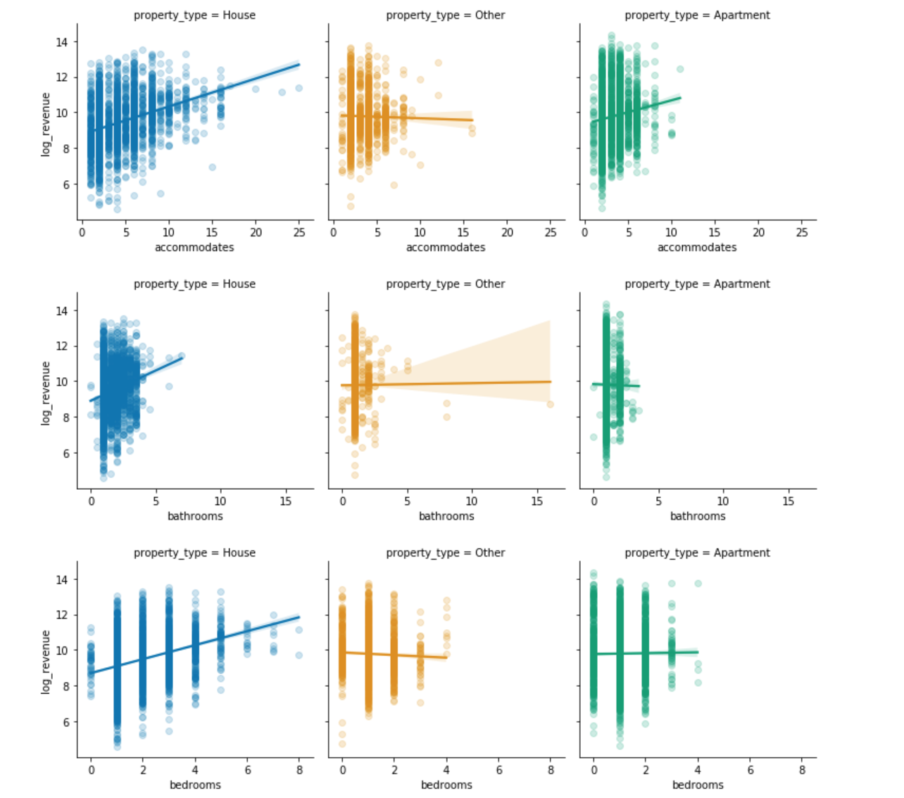
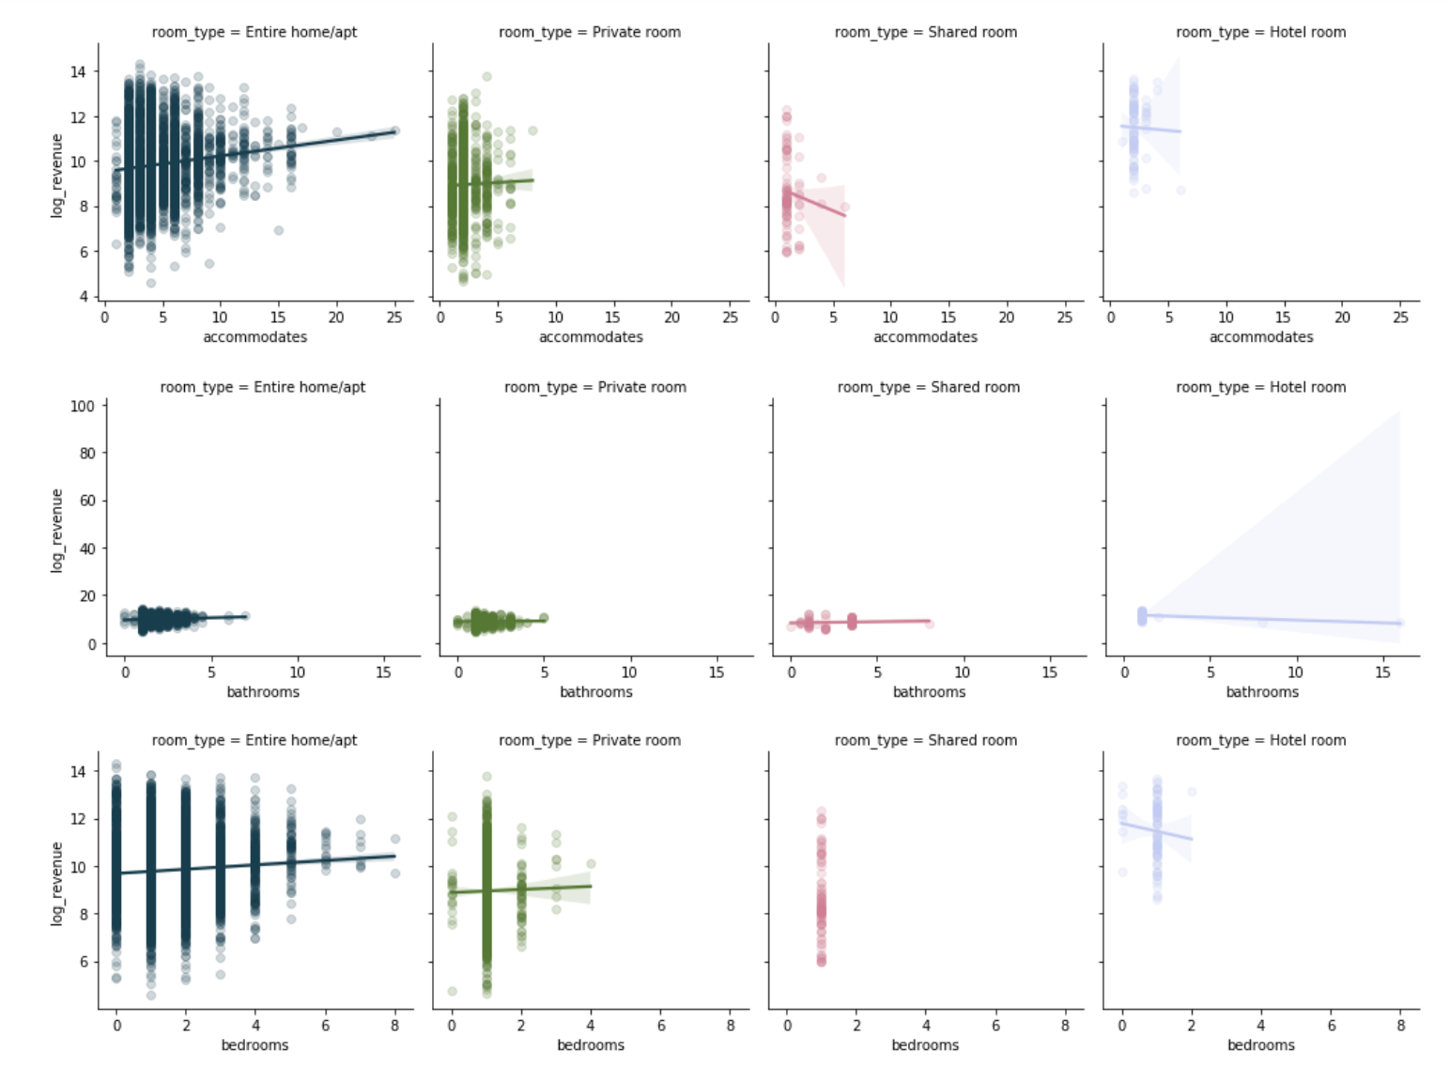
Listing Accommodates & Facilities
Bedrooms & Bathrooms & Accommodates

Slide 11
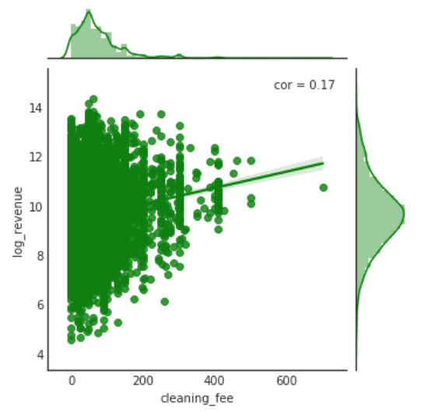
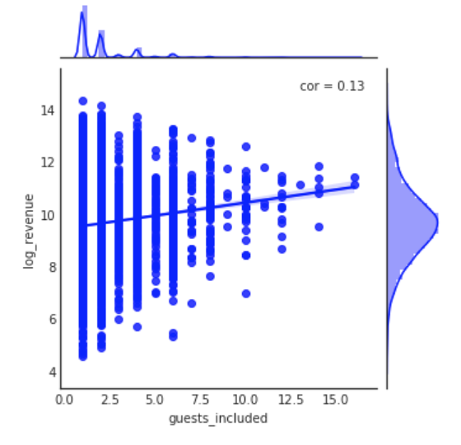
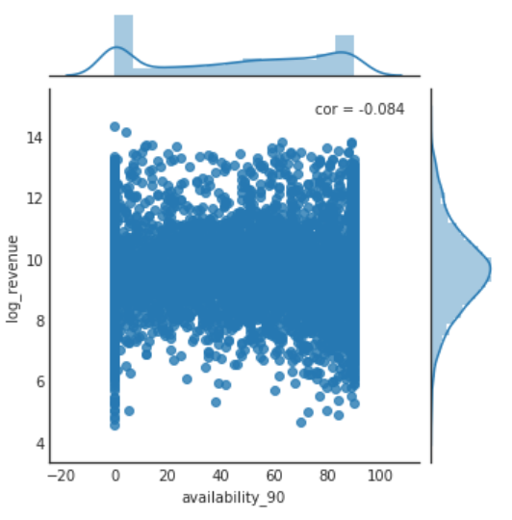
Listing Accommodates & Facilities
Clean Fee & Guest Included & Availability

Slide 12
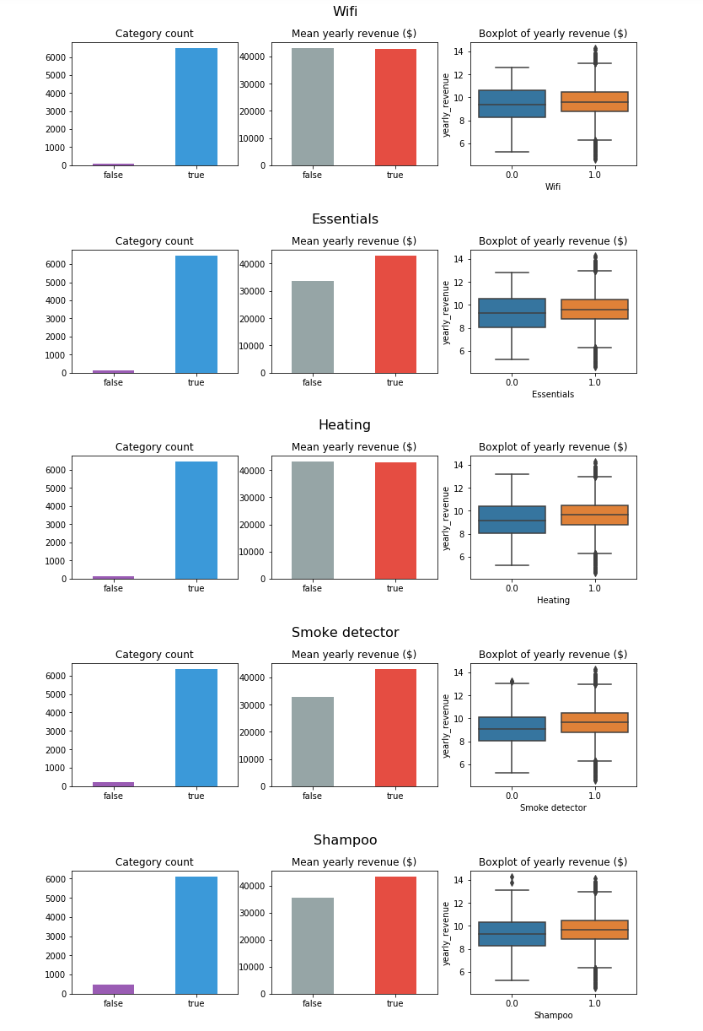
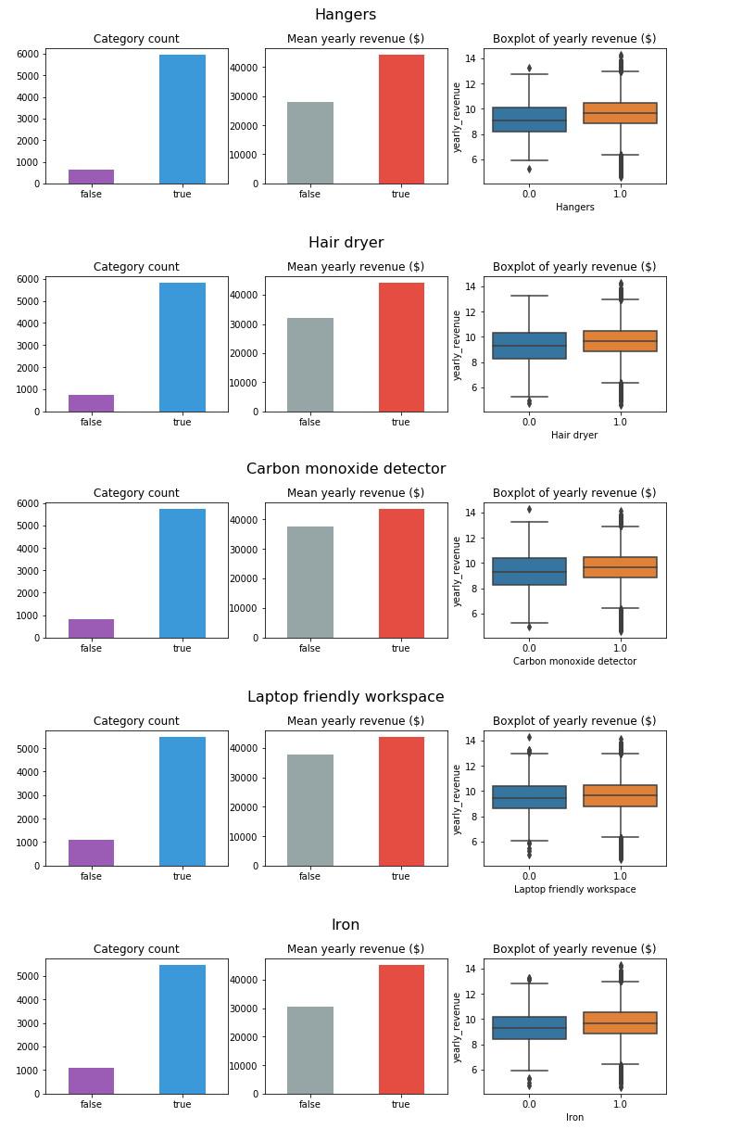
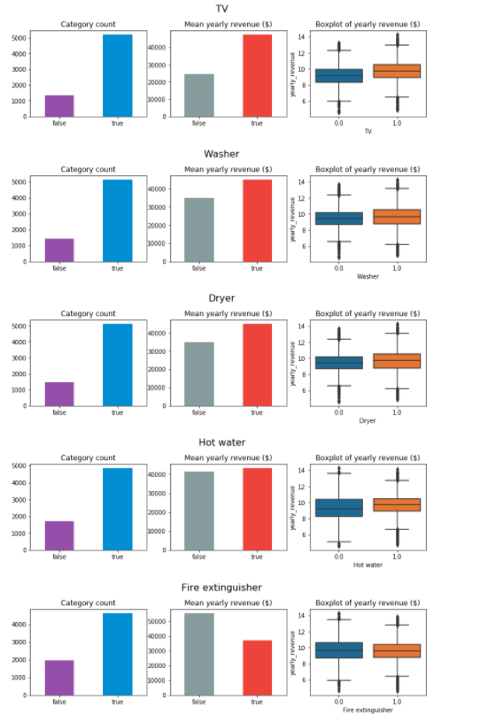
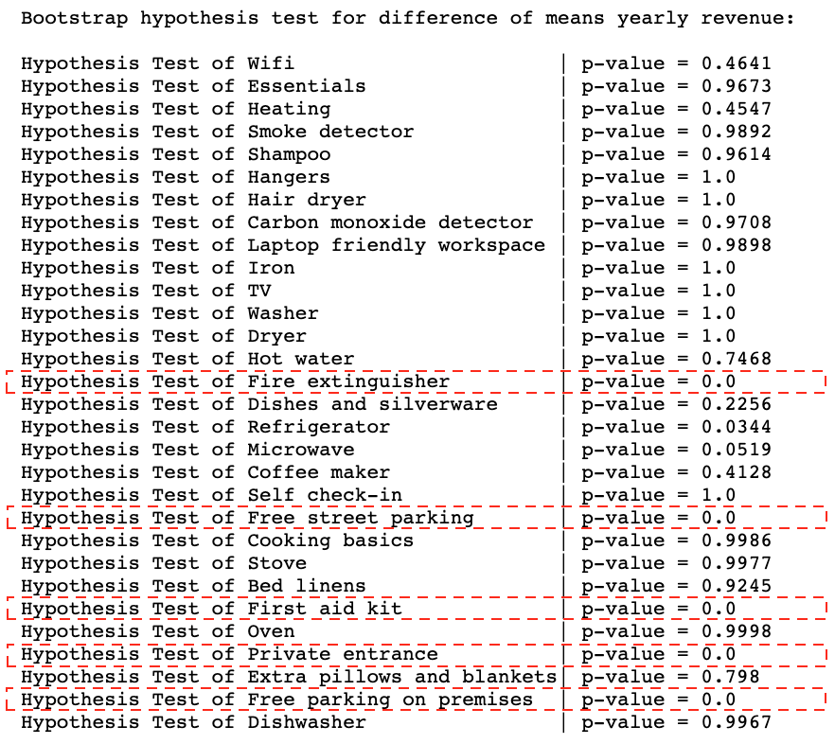
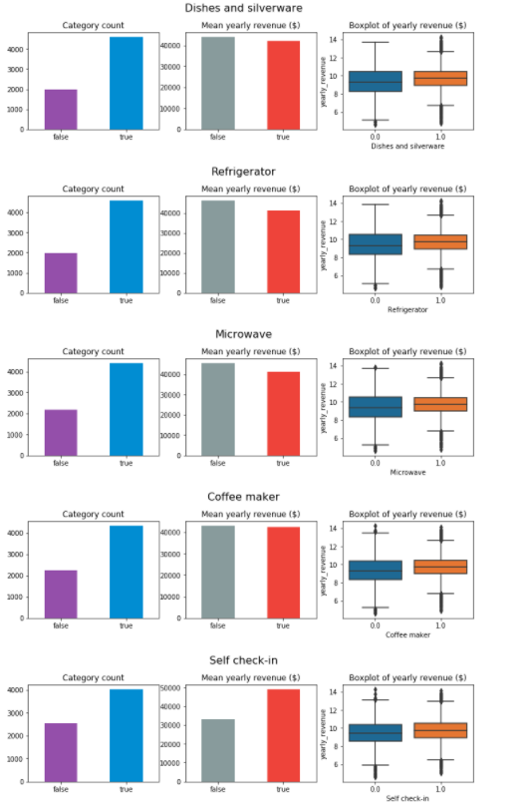
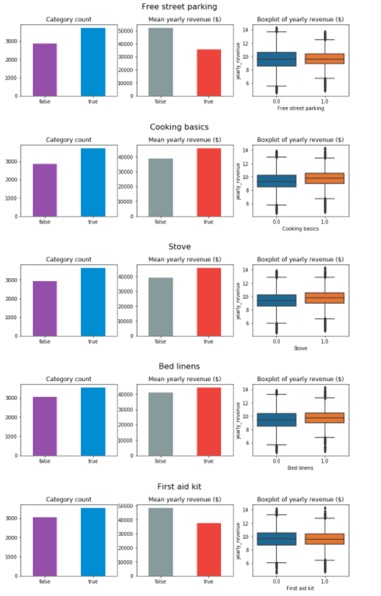
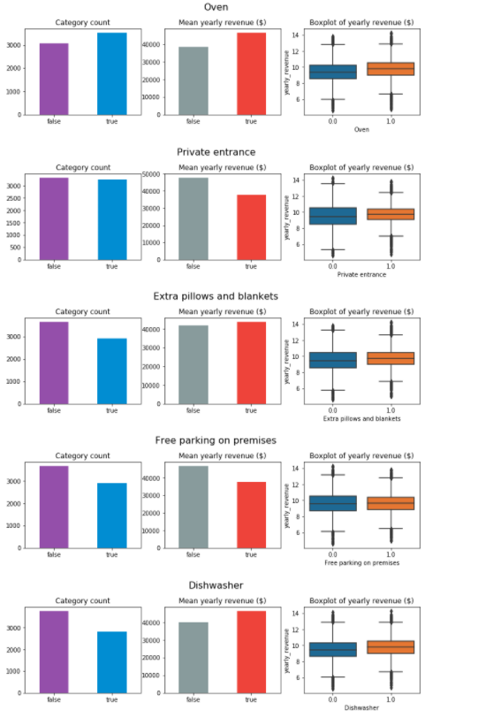
Listing Accommodates & Facilities
30 Amenities

Slide 13
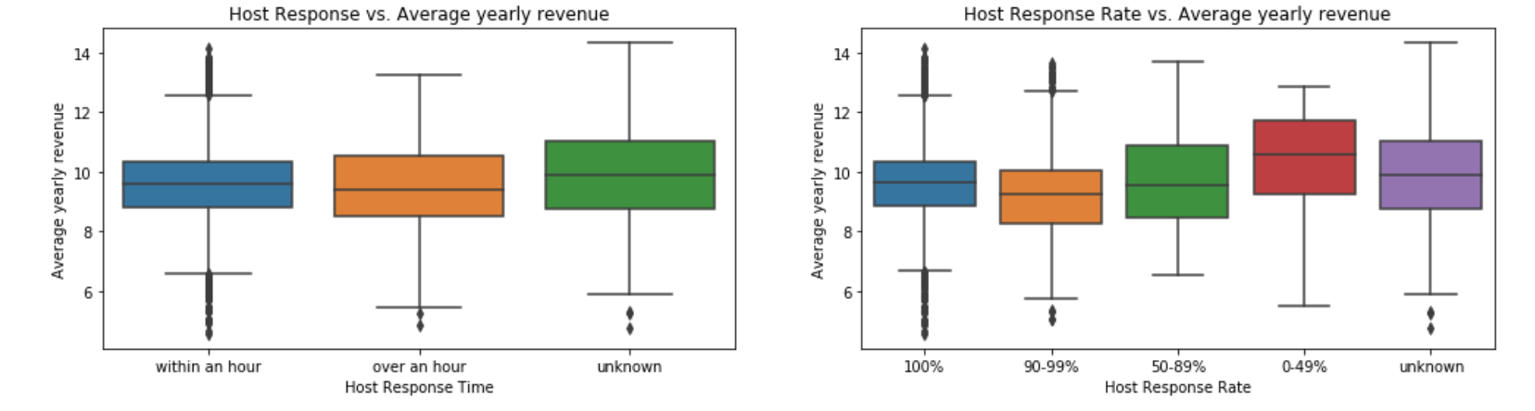
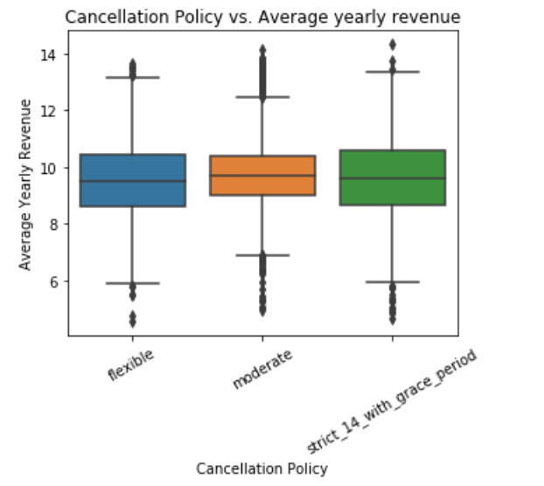
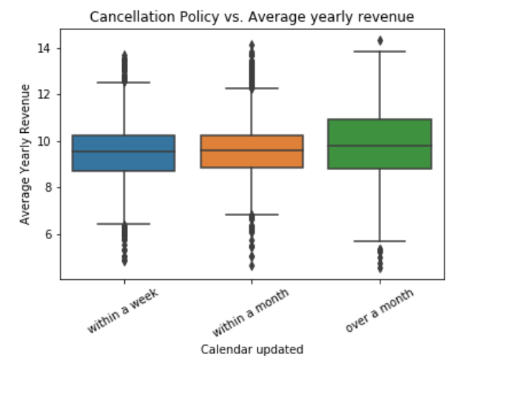
Interactive Relationship
From Host’s Side

Slide 14
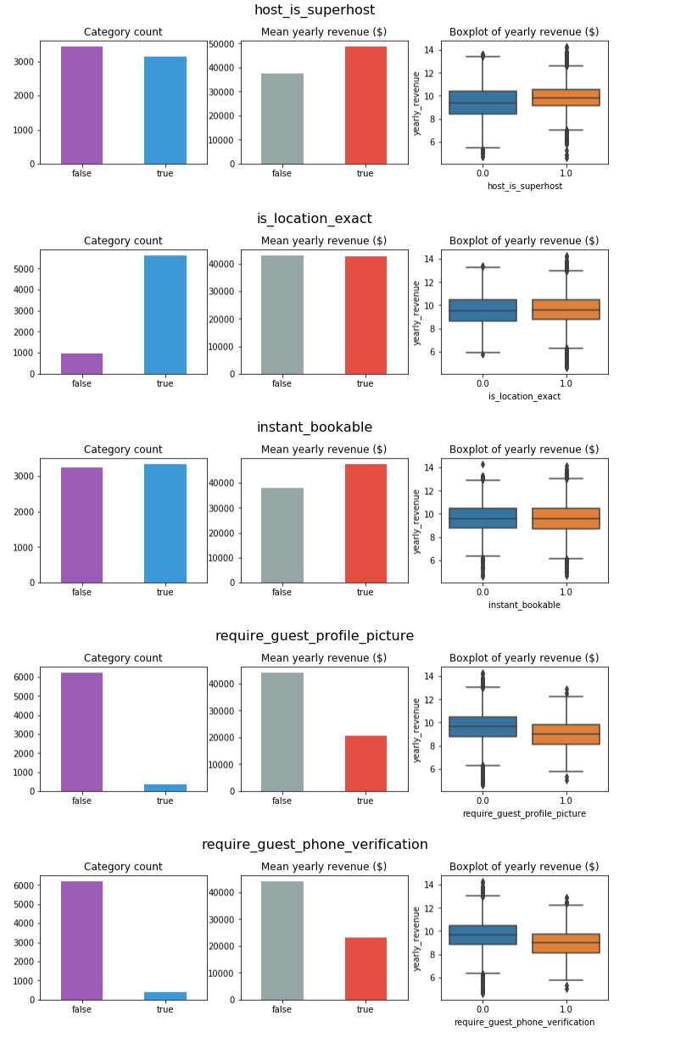
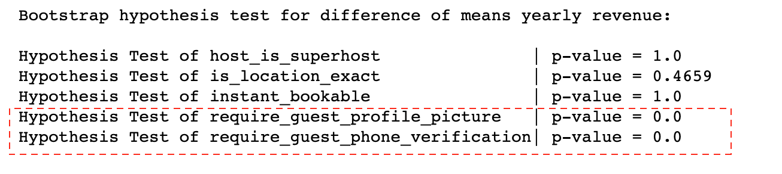
Interactive Relationship
From Guest’s Side

Slide 15
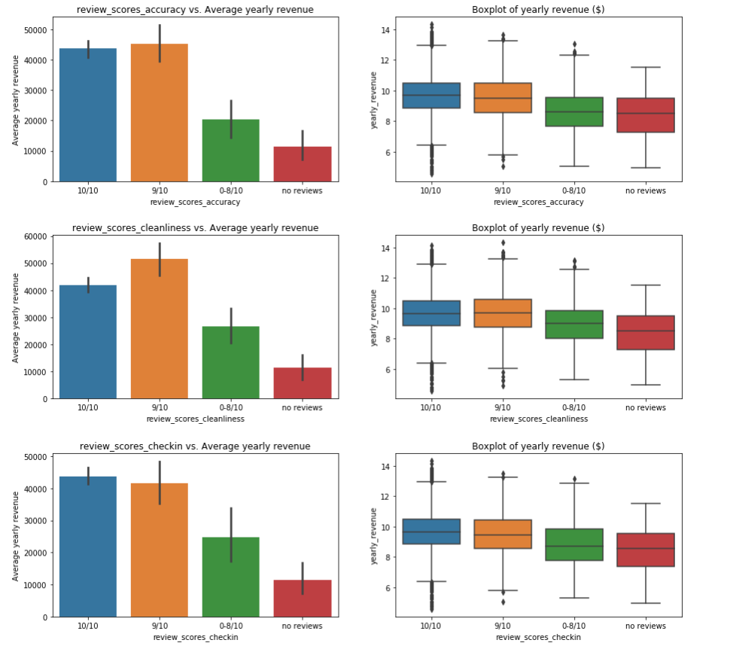
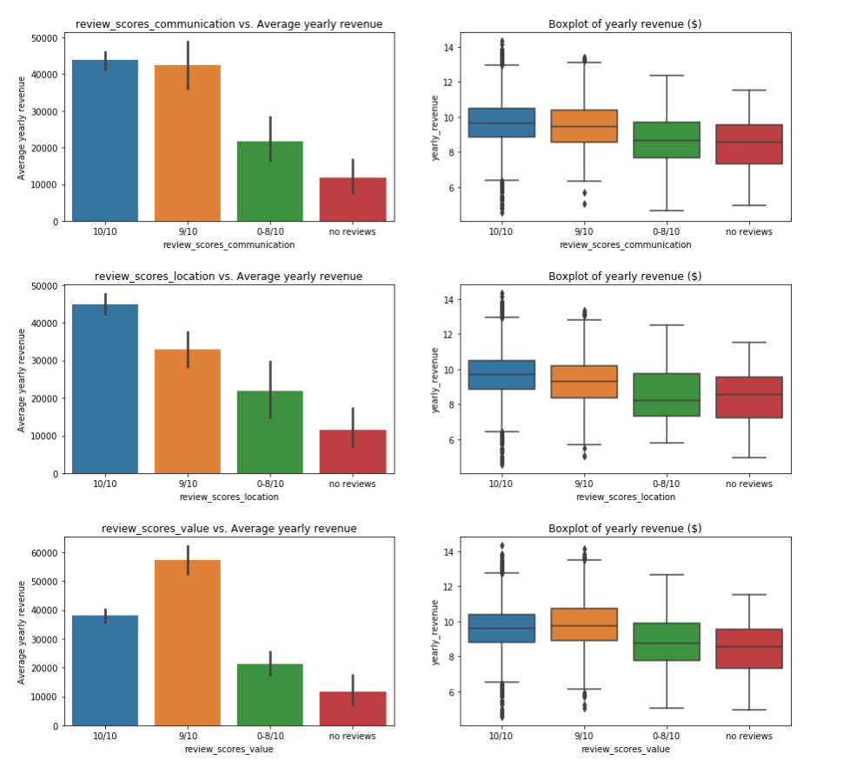
Interactive Relationship
From Guest’s Side
Review Rating Score

Slide 16
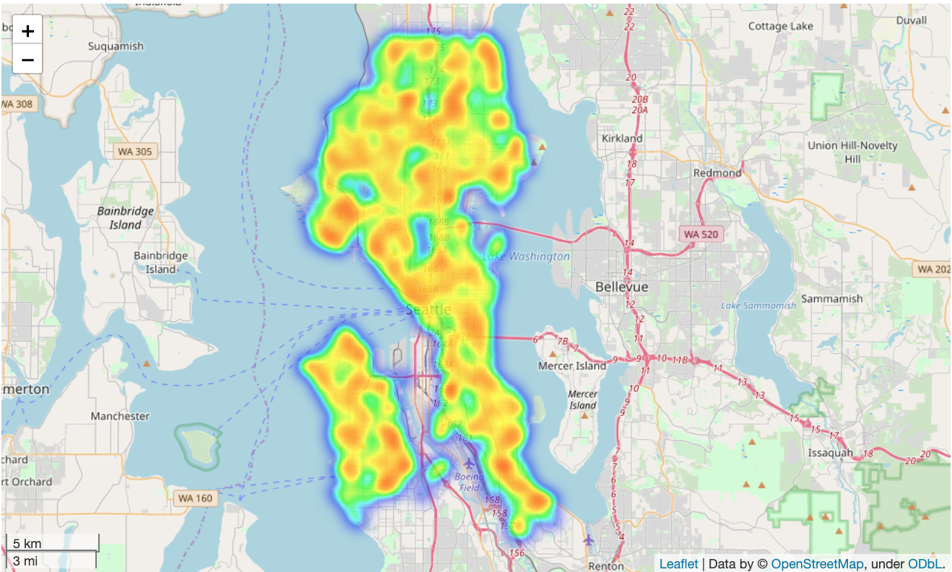
Geographical Information

Slide 17
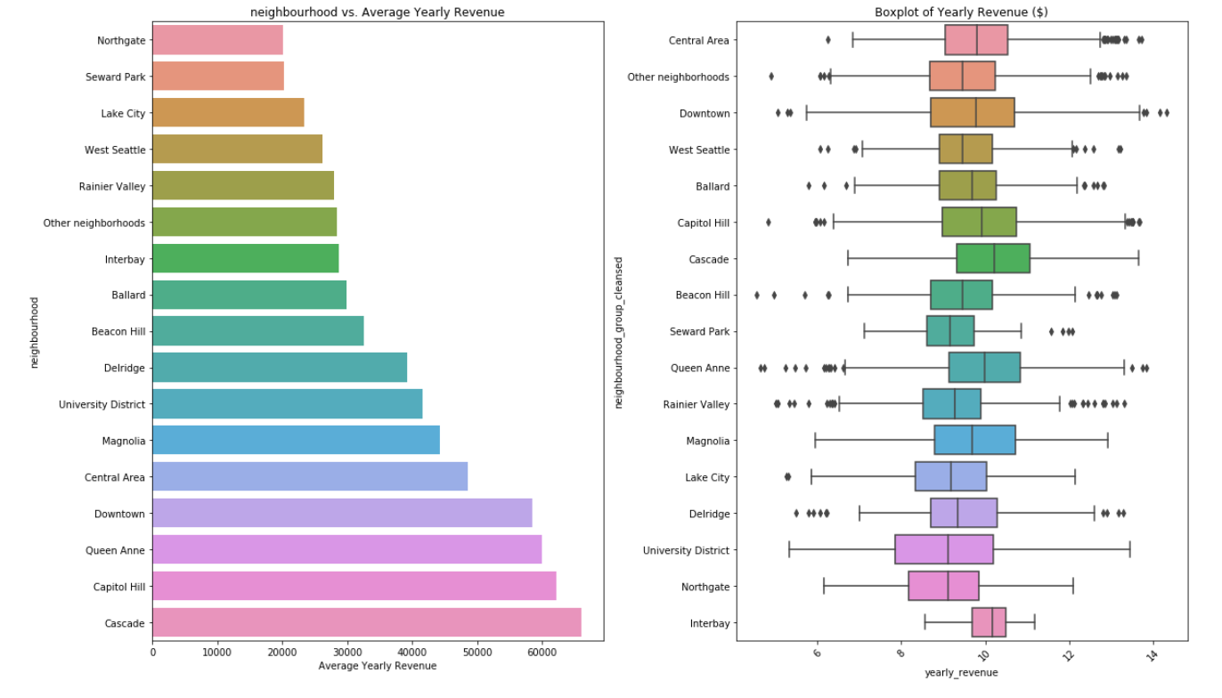
Geographical Information

Slide 18
Machine Learning Modeling
Preprocessing Data
- Access Collinearity
- Normalizing & Standardizing
Evaluate & Compare Machine Learning Models
- Model to evaluate
- Model Optimization

Slide 19
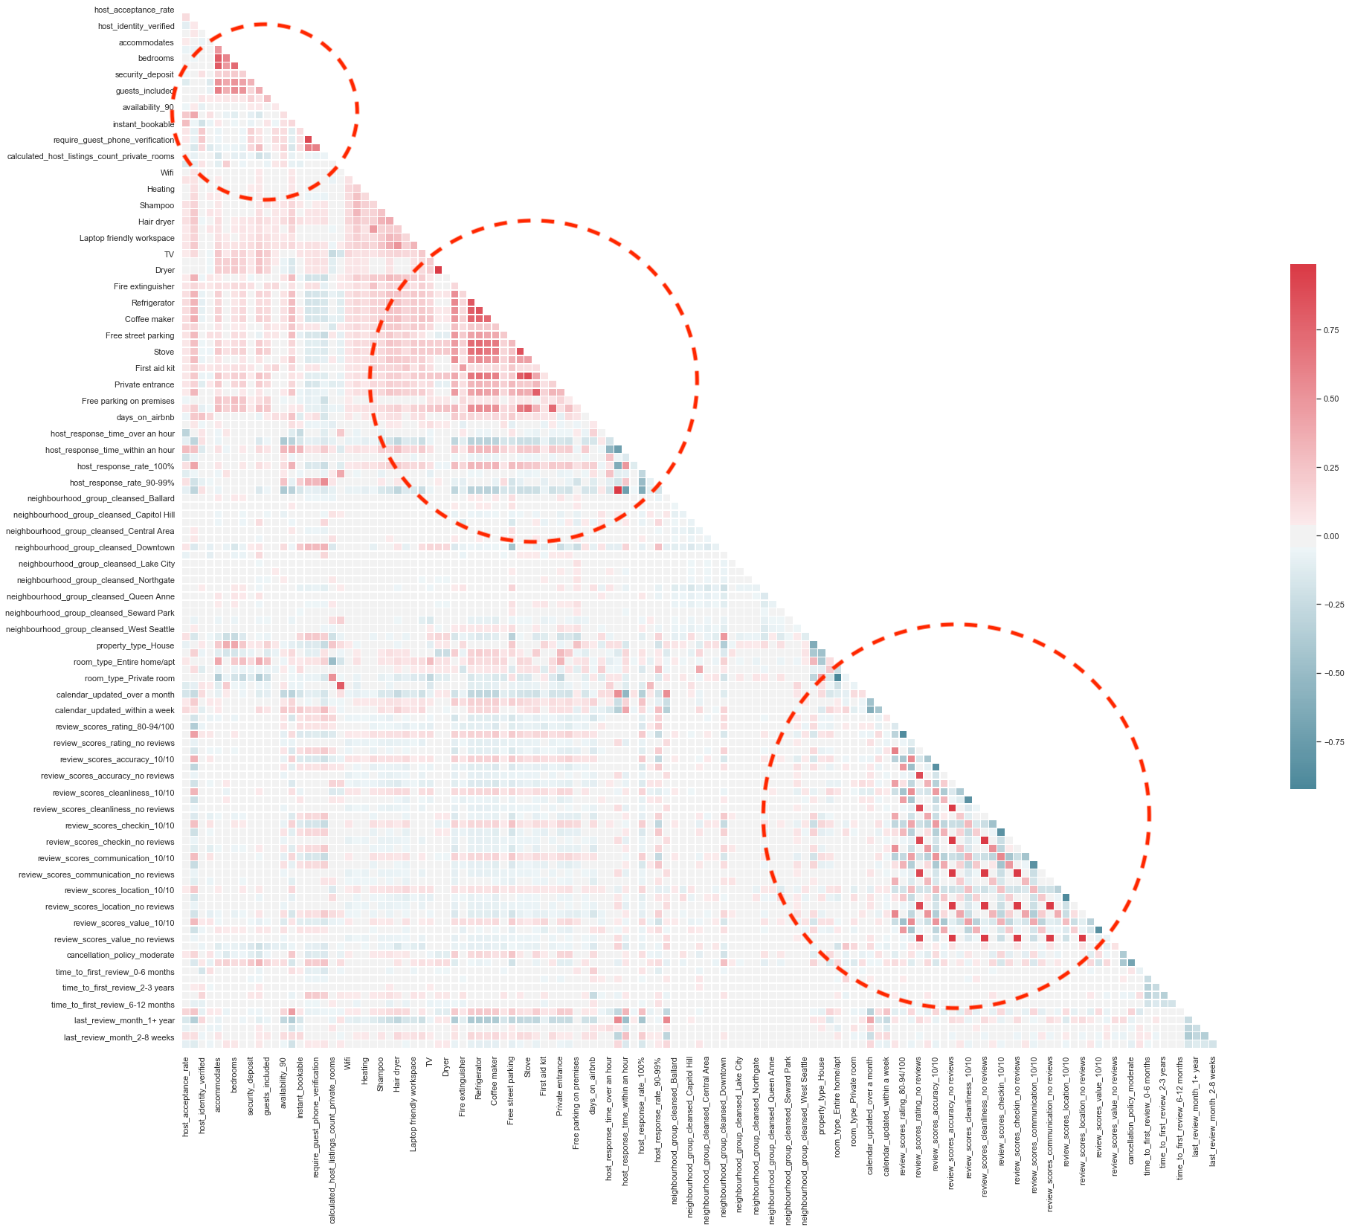
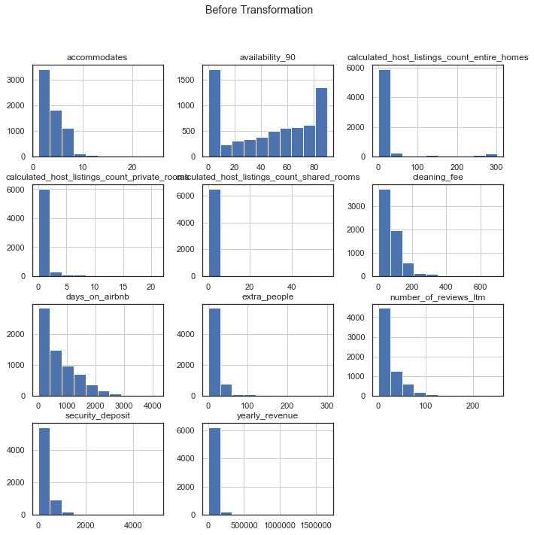
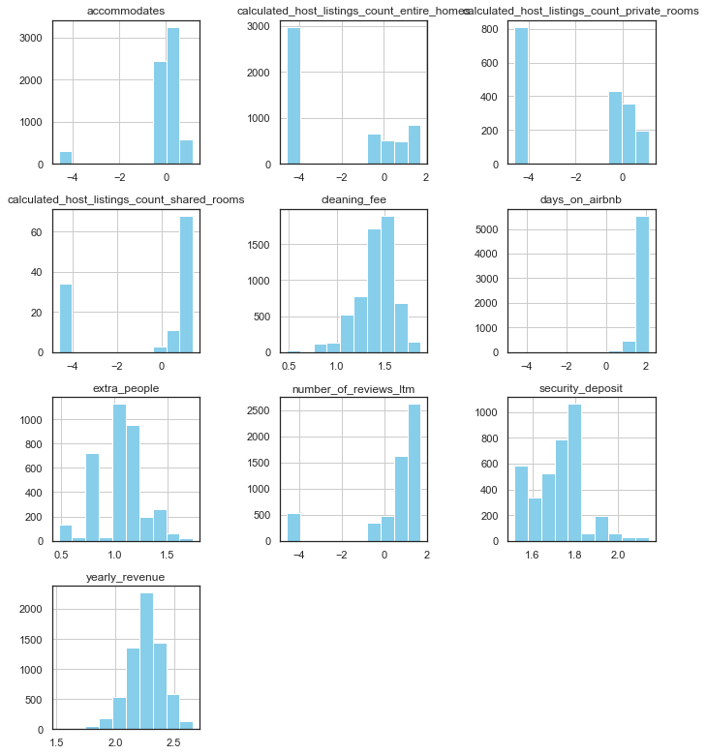
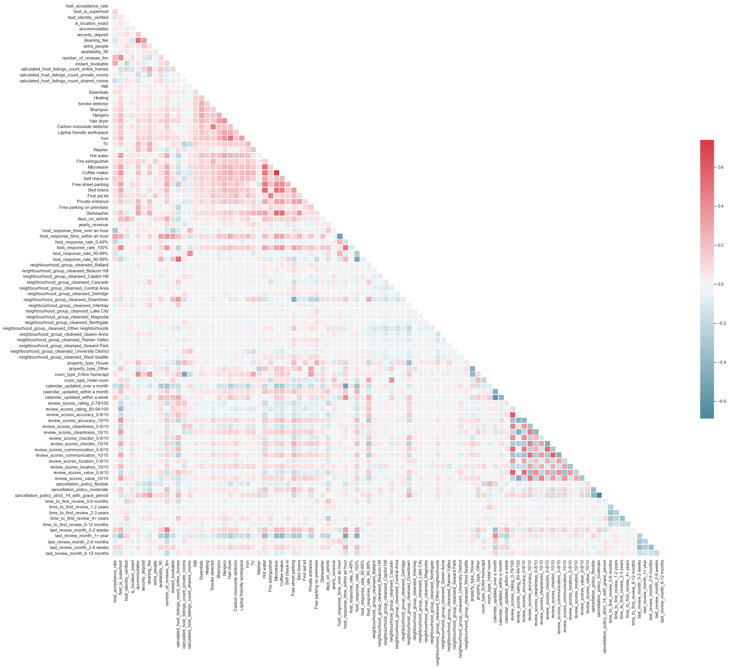
Preprocessing Data
Access Collinearity
Normalizing & Standardizing

Slide 20
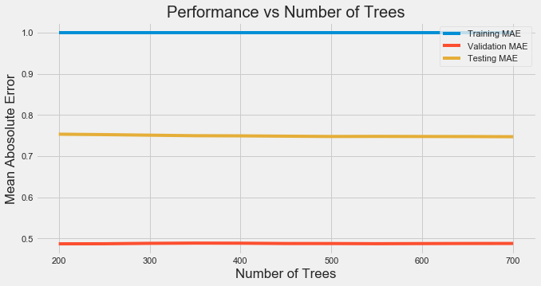
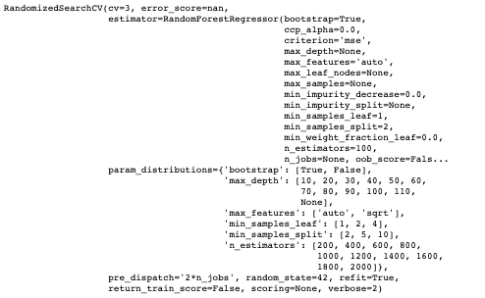
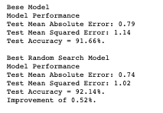
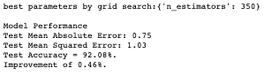
Evaluate & Compare Machine Learning Models
Model Optimization :: Random Forest
Hyperparameter Tuning: random Search; Grid Search
Cross -Validation
Random search with specified range
Visualize evaluate metric for CV and test
Random search best model
Re-iterate with grid search with narrower range

Slide 21
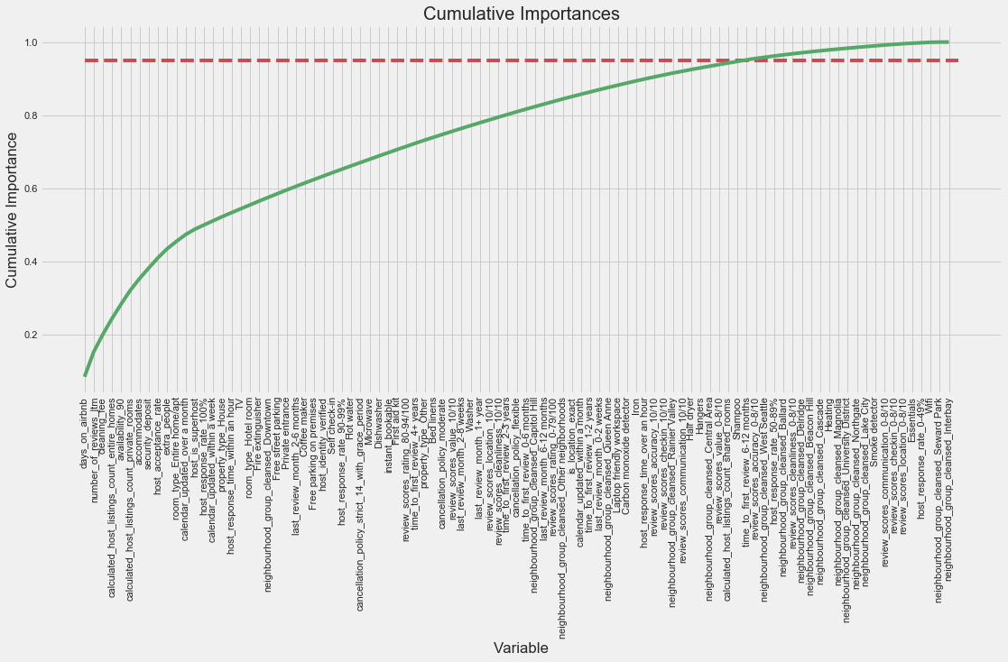
Evaluate & Compare Machine Learning Models
Model Optimization :: Random Forest
- Feature Reduction

Slide 22
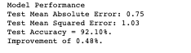
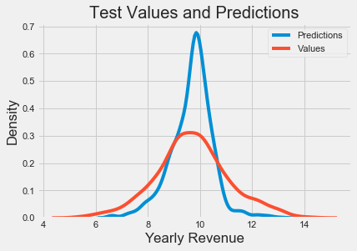
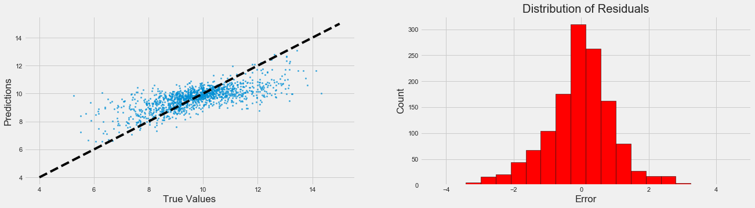
Evaluate & Compare Machine Learning Models
Model Optimization :: Random Forest with Reduced Features
- Model Performance

Slide 23
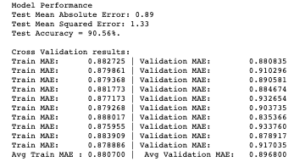
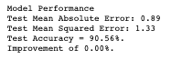
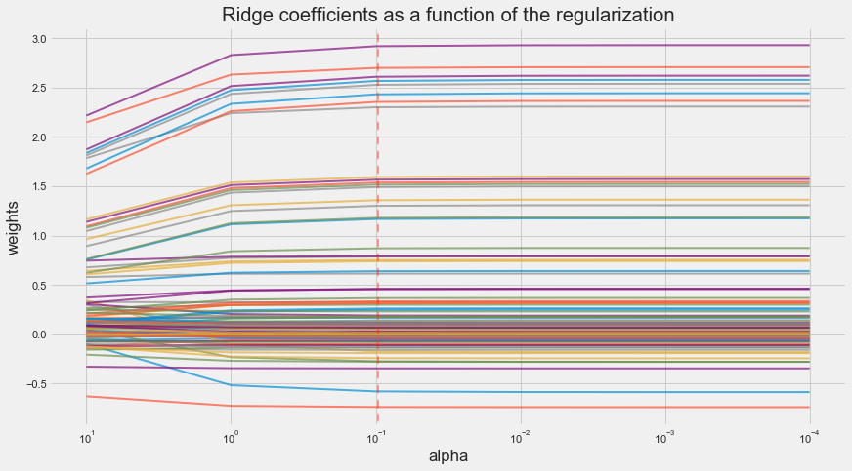


Evaluate & Compare Machine Learning Models
Model Optimization :: Linear Regression with Regularization
Linear Regression Base Model CV Results
Best Model – Alpha = 0.1
Note: Not improve much
Regularization Process and its CV Results

Slide 24


Evaluate & Compare Machine Learning Models
Model Optimization :: Model Comparison

Slide 25


Conclusions – A take-away message
Top 20 Important Features to Pay Attention To!

Slide 26
conclusions
87% of features contributed to the predictive power of the model.
Out of 5 supervised machine learning model, the Random forest provided the best results.
Out of 106 features, we used 72 features for the best model, and part of them were features engineered.
With 80% - 20% splitting, the test data was standardized with train data parameter.
With more ideas, the model can be improved in the features.

